Slide 1


Applications of phylogenetics in disease outbreak
Ifeanyi Omah
Rambaut Group
University of Edinburgh

Slide 2
How to roughly scale the ML tree in time
Software: Treetime
conda install -c bioconda treetime
treetime --sequence-length <length_of_alignment> --tree <input.nwk> --dates <dates.csv> --keep-root
“name”, “accession” or “strain” and one should be “date”.
gotree compare trees --reftree <ml_tree.nwk> -c <timetree.nwk>

Slide 3
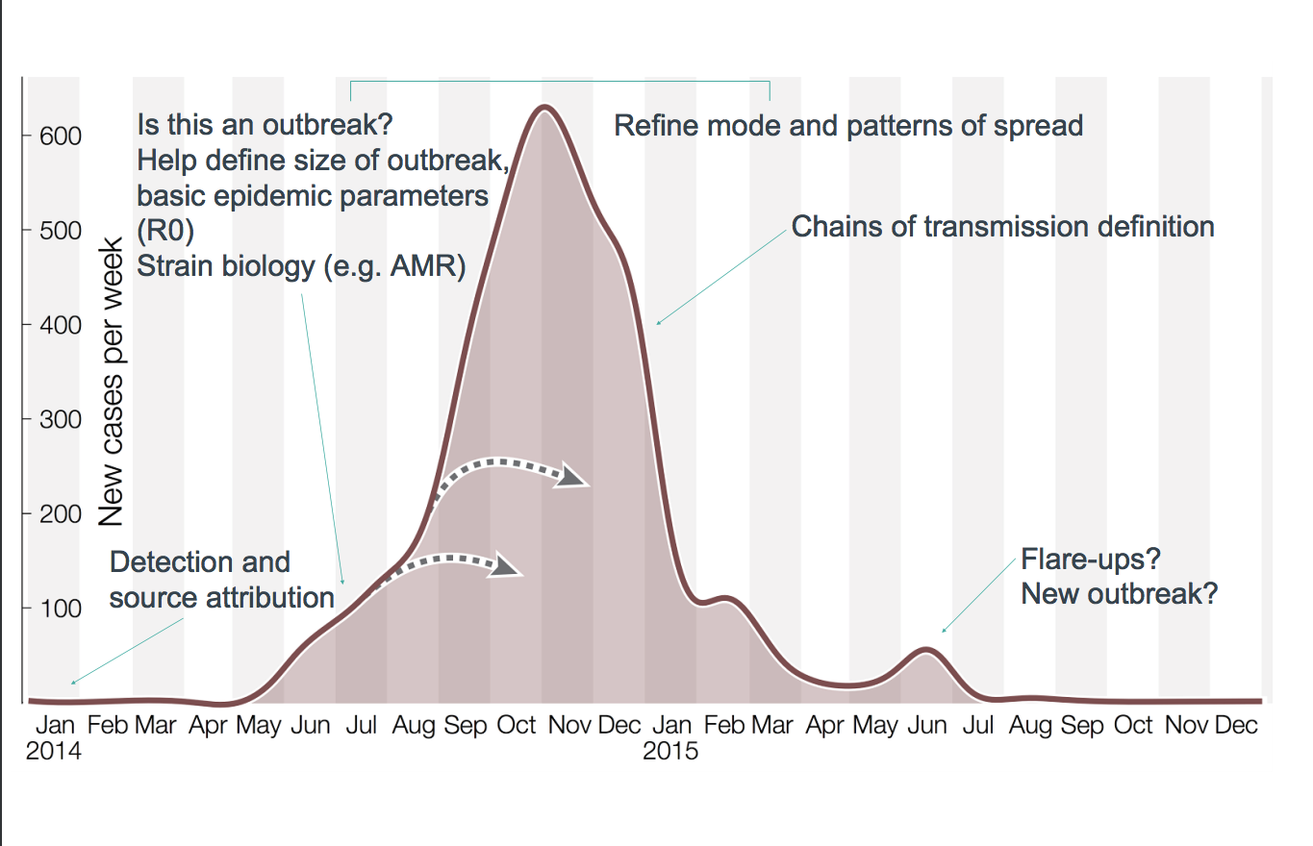

Slide 5
Detection
Diagnosis –what is it?
Detection and characterisation of novel pathogens
How long ago did the outbreak start?
Notes:
You already know about how to use PCR to diagnose pathogens, but it’s helpful to know where it falls on the tree.
What species is it? Is it similar to others we’ve seen before, or a new strain of the pathogen?
Is it completely novel?

Slide 6
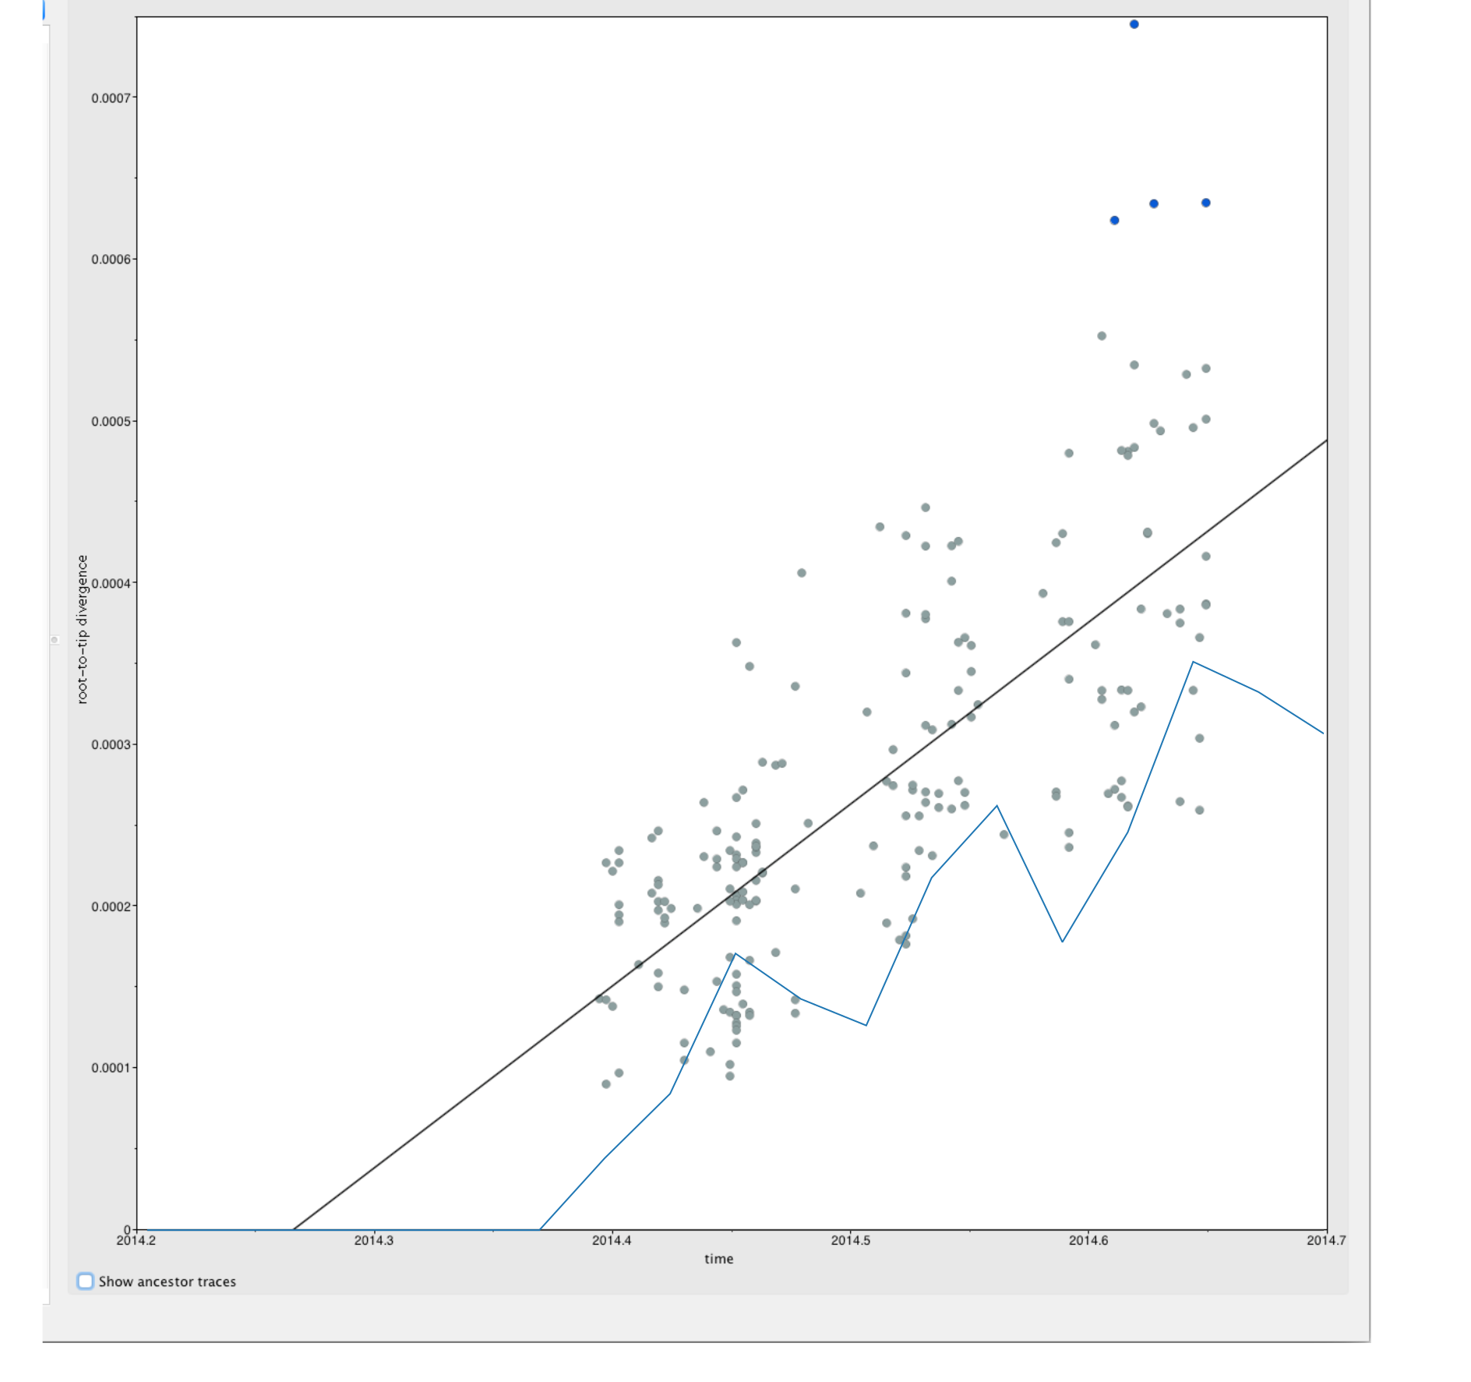
Notes:
I’ve shown you this before – this gives us an idea of when Ebola entered Sierra Leone. In this example, this says it entered in 2014.3, which is March 2014.
You can see that the case counts didn’t start rising until a long time after (end of May). This is the key bit, this outbreak start to detection.
This is useful because we hardly ever catch an outbreak in the first few cases, so it’s helpful to know if we have caught quickly or not. We can also then
Especially useful when the symptoms are less obvious
For Ebola, the transmission is specific and the later symptoms are quite distinctive (especially when combined with the mortality rate). So for Ebola, they tracked the West African outbreak back to Meliandou through shoe-level epi (was helped by genomes) because the transmission is quite distinctive, and you tend to get large clusters of people dying (even if the early symptoms are non-specific).
For insect-borne viruses this is harder, because it’s harder to trace the person to person transmission so it’s much harder to get the clues you need to find the origin

Slide 7
Case study: Zika virus in the americas
Zika virus is a flavivirus (related to Yellow Fever virus) transmitted by Aedes mosquitos, and with evidence of sexual transmission.
It was discovered in Uganda in the 1940s, but didn’t cause a large outbreak until 2007 in Yap (South-East Asia), then island-hopped across the Pacific and was confirmed in Brazil in May 2015.
Difficult to diagnose – flu-like symptoms
Associated with large increase in microcephaly (small brain size) in infants born to mothers who had been infected while pregnant.
Declared a PHEIC in February 2016
Notes:
Outbreak in yap – before that only 14 human cases documented

Slide 8
When and how did zika get to brazil?
Three concerns:
2014 Men’s Football World Cup (July)
2014 Va’a Canoe event (August)
2013 Confederations Cup Soccer tournament
The second two also featured participants from French Polynesia, which had an outbreak shortly before Brazil.
BUT because it’s vector-borne with non-specific symptoms, difficult to trace epidemiologically

Slide 9
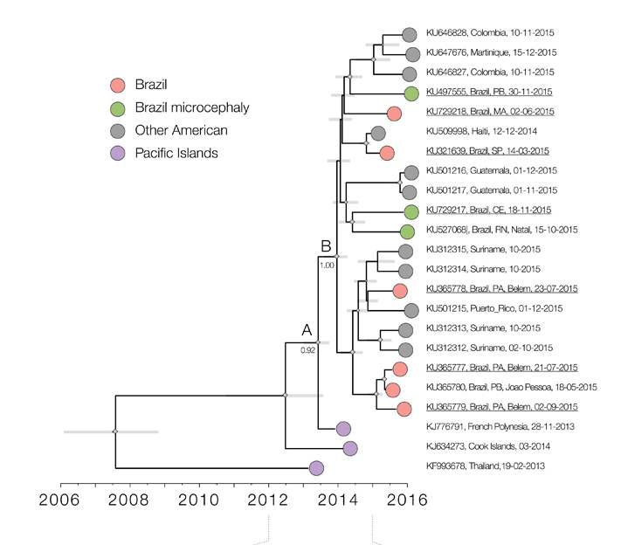
Faria et al (2016) Zika virus in the Americas: Early epidemiological and genetic factors Science 352(6283) p345-349
Notes:
They made a tree w some zika seqs from the Americas
They found a) that it was a single clade – all of the sequences were related to each other and had one common ancestor, which suggests a single introduction event
And b) they found it was between August 2013 and April 2014. This is a wide interval because there aren’t many sequences BUT it allowed them to rule out world cup and canoeing event as introductory events, and the confederations cup as very unlikely because Zika hadn’t made it to French Polynesia yet, which is where it was stipulated the virus came from.
Points to normal human migration as a more likely cause.
This affects how we treat sporting events around the world as public health things.

Slide 10
Geographic source
What location has it come from?
Is it a continuation of an outbreak going on nearby or a new spillover event?

Slide 11
Ebola in the DRC
The DRC was declared free of Ebola in July 2018, after an outbreak in the South West of the country
A few weeks later, cases were discovered in the North East.
Concern was that somehow the outbreak had spread all of the way across the country and had been missed – or was it new?

Slide 12
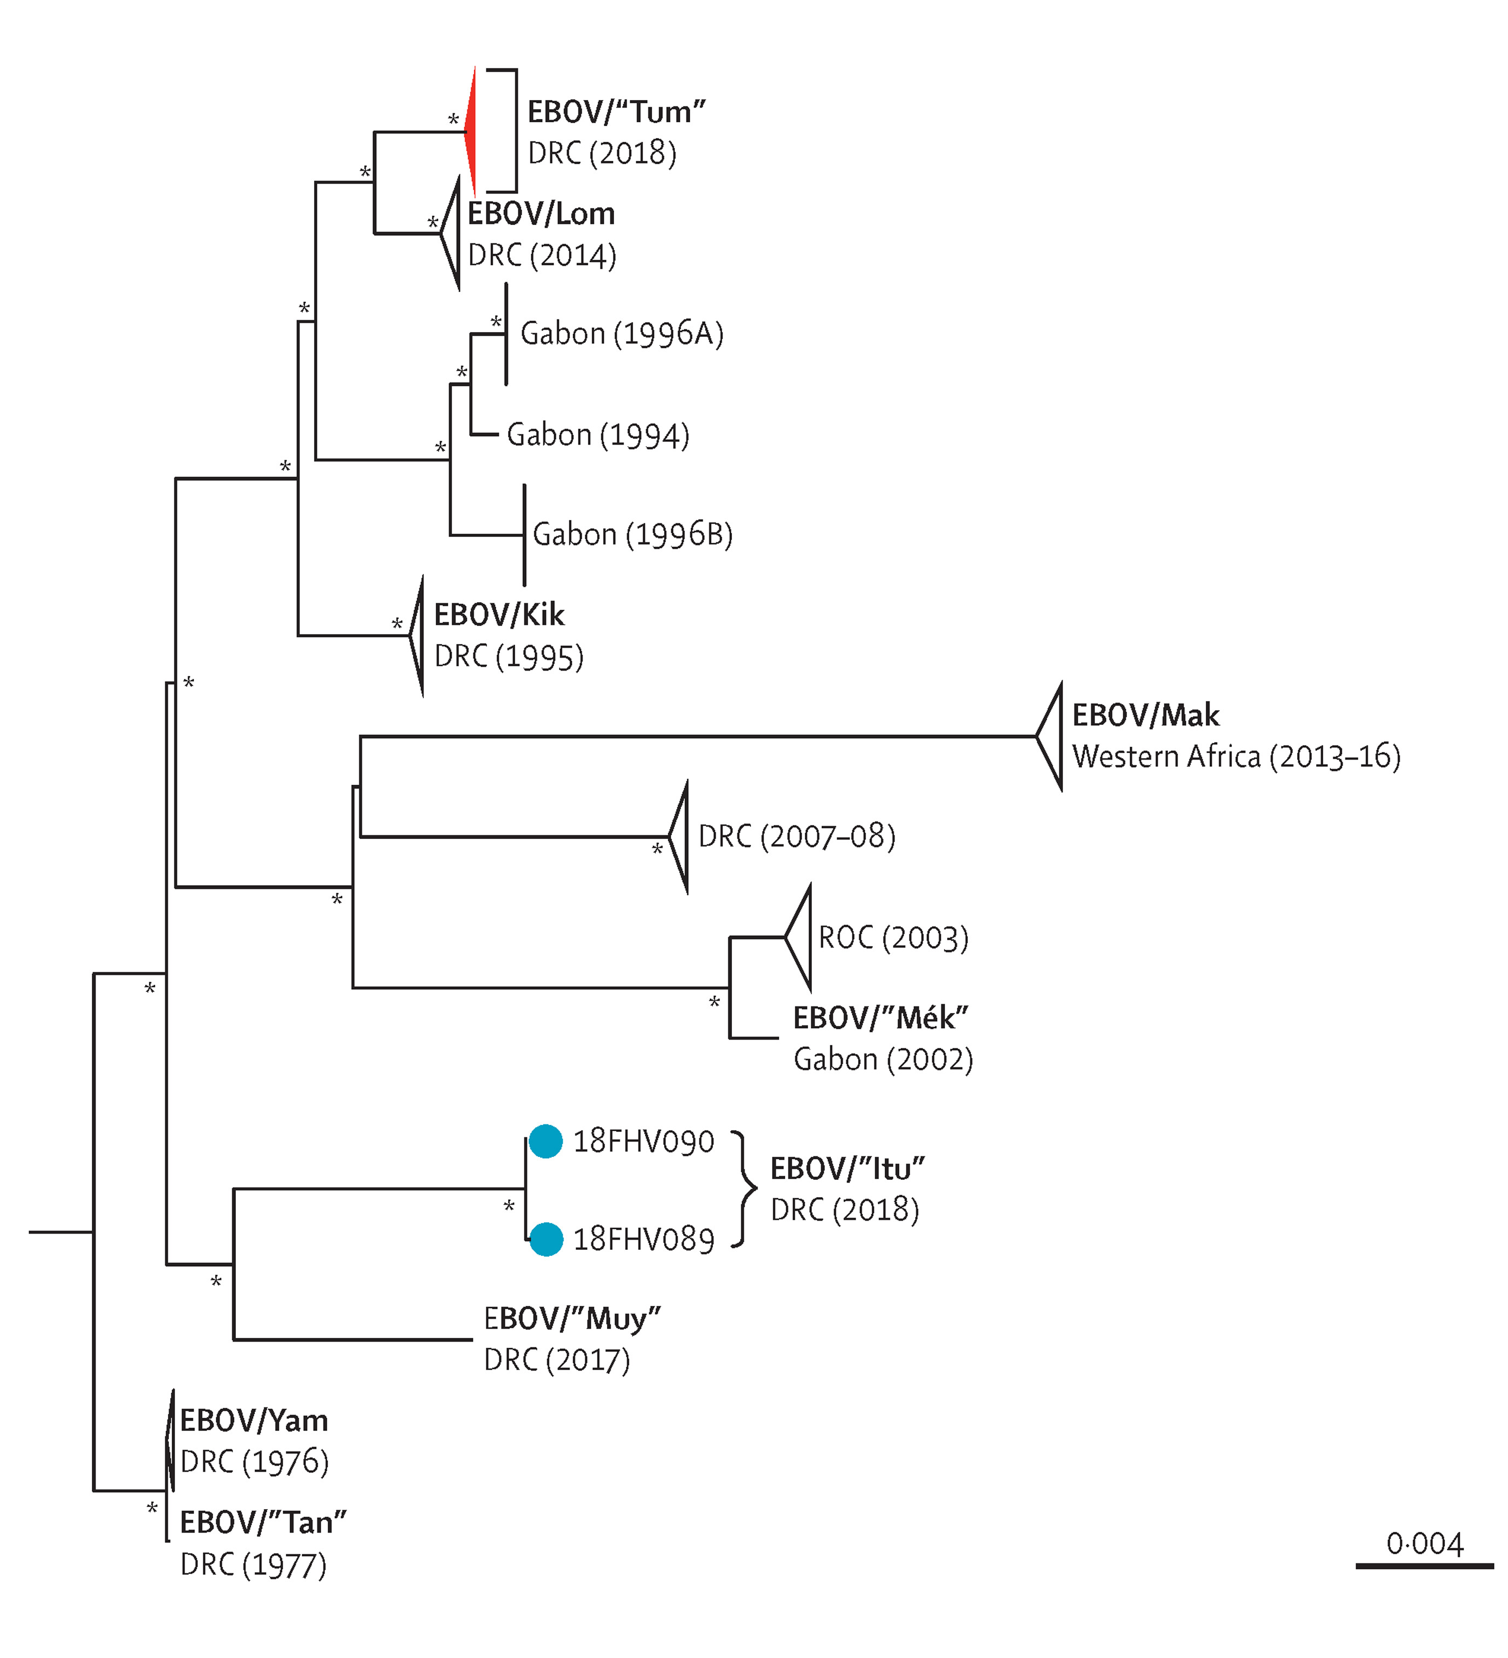
Mbala-Kingebeni et al (2019) Medical countermeasures during the 2018 Ebola virus disease outbreak in the North Kivu and Ituri Provinces of the Democratic Republic of the Congo: a rapid genomic assessment The Lancet 19(6) p 648-657
Notes:
Here, the authors showed that the current outbreak of Ebola in DRC is a separate one and not a continuation of the outbreak that had only finished a month earlier
Old one was the Tum one at the top and then the new one is Itu nearer the bottom.

Slide 13
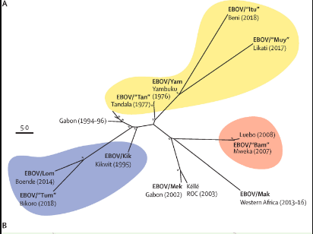
Mbala-Kingebeni et al (2019) Medical countermeasures during the 2018 Ebola virus disease outbreak in the North Kivu and Ituri Provinces of the Democratic Republic of the Congo: a rapid genomic assessment The Lancet 19(6) p 648-657
Notes:
Another interesting aspect of this is the location of the outbreaks.
This is a type of tree you haven’t seen before – it’s called unrooted. But it’s the same principle – the length of the branches from the node gives the genetic distance.
This also showed them that it clusters by location even within DRC, suggesting fragmentation of the underlying reservoir host population – this may give us more clues to what the reservoir host of Ebola is.
This kind of geographic clustering is seen in lots of pathogens with a reservoir in wild animals because they tend to move less than humans or livestock do. We also see this kind of clustering in Monkeypox and Lassa Fever.

Slide 14
Animal source
What host has it come from? Or is it endemic in humans?
Notes:
I’m going to give ane xample of HIV – HIV has multiple subtypes, but there are two broad ones – HIV-1 and HIV-2. HIV-1 is the pandemic strain, 99% of people with HIV have HIV-1. HIV-2 has never left central Africa – what’s the difference? One option could be where it came from

Slide 15
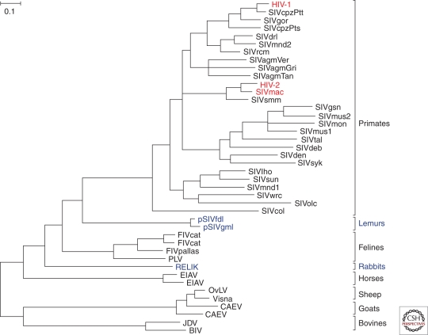
Sharp and Hahn (2011) Origins of HIV and the AIDS pandemic Cold Spring Harbour Perspectives in Medicine 1(1)
Notes:
HIV tree shows clustering of HIV-1 within SIV cpz, and HIV-2 with macaques, so we can see that they came from two different hosts

Slide 17
Key outbreak parameters
Growth – is the pathogen population growing or shrinking?
Effective population size
Notes:
This is quite a difficult problem, but it’s one of the first things people worked on when virus sequencing became a thing
Used to be that we used idealized populations and made rules based on that
But this is actually very difficult because there’s a lot of hidden things, lots of important context that mean simple rules don’t work very well
And populations usually don’t change in simple ways – it’s not just exponential growth/decline or constant
So we made some models! We use effective population size, which does require one of the more complicated ways of tree building that I mentioned in the other lecture. Don’t worry about if for now, if you’re interested I can point you towards some resources, but for now just giving you idea of questions you can ask

Slide 18
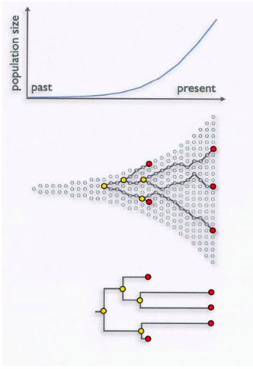
Courtesy of Andrew Rambaut
Notes:
The simplest case says that if you have lots of long branches, it means the population is growing.
This is because in a larger population, it takes longer to find the point when two pathogens last had a common ancestor, giving a long branch
BUT in reality, things are a little more complicated than that because pathogen populations usually don’t change in a simple way like this. They grow and shrink across time
Long branches could also mean that you’re simply not sampling enough – you’re missing

Slide 19
Effective population size
Measure of population size based on genetic diversity
It won’t give you absolute numbers, and should not be used as such
Difficult conceptually, but we can use it as a tool to examine patterns of population growth and decline
Notes:
Broadly speaking – more diverse indicates bigger pop size
If you sample three people in an outbreak and they are closely related to each other, then it suggests that that population is small
If they are diverse, then implies that it’s bigger
Caveats, context etc but the key take away here is that you can infer dynamics from genomes

Slide 20
(brief) Ne description plus skygrid
Skygrid of west Africa mapped on top of cases
Verity Hill
Notes:
Ne is a measure of pathogen population size based on the diversity of the pathogen population. Broadly, the more diversity, the larger the population is li kely to be
Importantly, it won’t tell you absolute sizes, but it will give you an idea of patterns
This is a figure of skygrid in blue and case counts in red from Sierra Leone ebola epidemic. You can see it’s not exact, but it gets overall trends well, and even the little bump at the end is captured. We’re not sure what’s going on with the big dip, but we’re investigating it.

Slide 21
Biological information about the strain: E. coli in Germany
In 2011, a particularly virulent epidemic of E. coli caused >4000 cases of bloody diarrhoea, 850 cases of haemolytic urinary syndrome and 50 deaths in Germany.
This can be caused by Shiga toxin-producing EHEC (enterohaemorrhagic E. coli)
Sequencing revealed it was a different strain (Enteroaggregative E. coli) that had acquired genes for Shiga toxin production and antibiotic resistance.
Shows the amount of horizontal gene transfer in E. coli and its relevance to public health – E. coli is more flexible that thought before
Rohde et al (2011) Open-source genomic analysis of Shiga-toxin-producing E. coli O104:H4 NEJM 365, p718-724

Slide 23
Case study: lassa fever
Uptick in cases in Nigeria in 2018
Concern that it had become more transmissible, and was passing human to human more easily
Difficult to tell with epidemiological data for sure – people may forget interactions with rodents, or have multiple exposures to sick people and rodents.
So was it spreading between humans? Or just more cases coming from rodents?

Slide 24
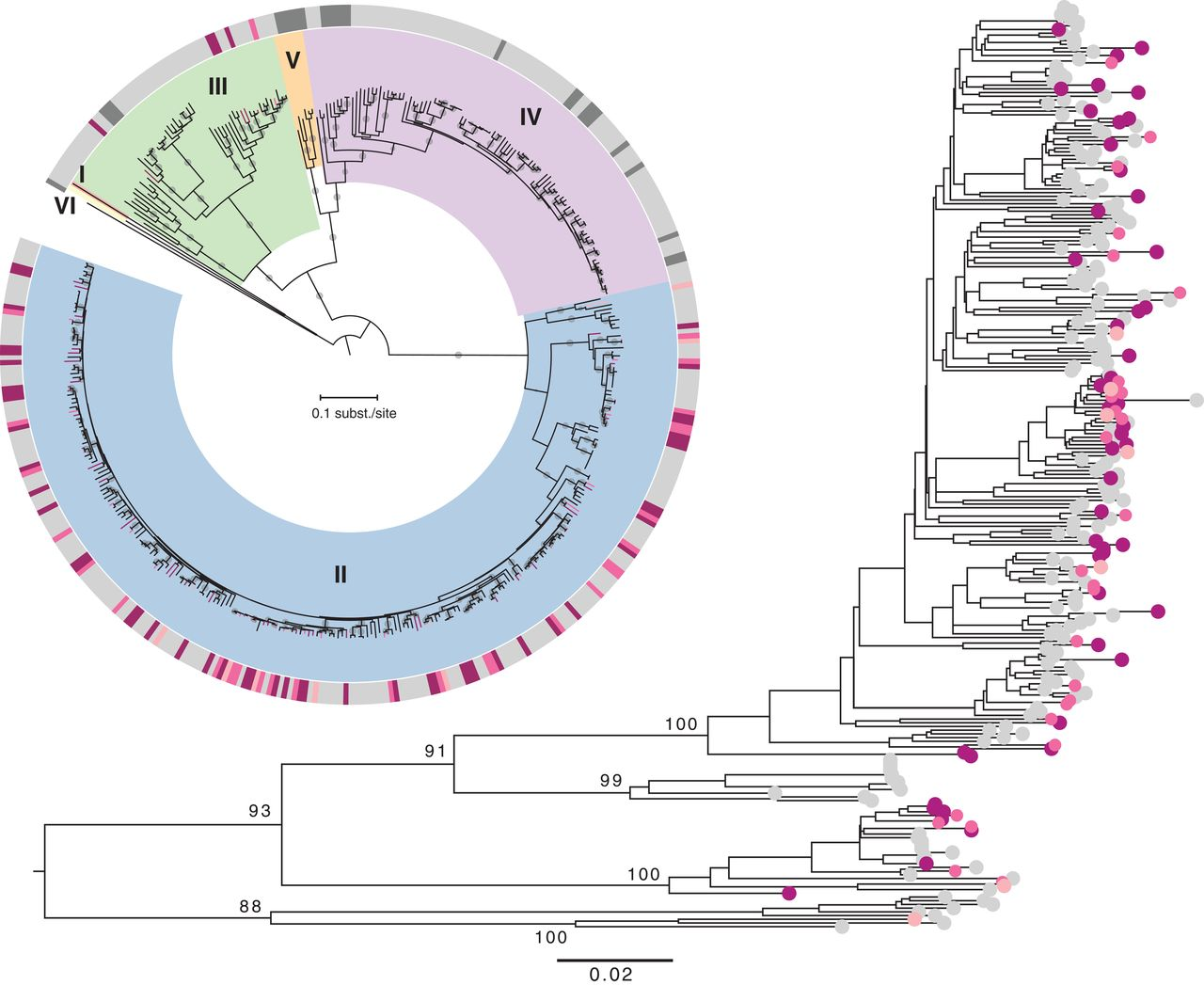
Kafetzopoulou et al (2019) Metagenomic sequencing at the epicenter for the Nigeria 2018 Lassa Fever outbreak Science 363(6422), p 74-77
Notes:
This tree on the right – the pink sequences are ones taken this outbreak from humans, grey are from rats
You can see that the pink ones cluster with the grey ones, suggesting that it’s continuous spillover from rats because they are more closely related to the rats than to other humans
One concerning cluster – but they then looked at this cluster in detail and found that the sequences were quite different from each other (ie more different than they should be if it’s direct transmission) and epi data provided no evidence for human to human transmission
[if they ask about Ne here – it would work but you would be describing the population dynamics of the virus in the reservoir host really. You need a monophyletic clade (basically one ancestor and all its descendents). Here we’d be sampling diversity from the rats as well, which is fine but might not be what you want. So the Ne should work quite well for describing the pop as a whole, but it wouldn’t be expected to match the human case counts well]

Slide 25
phylogeography
Can treat location as a trait that is “evolving” across the phylogeny
We can apply a substitution model like we did with nucleotides! Uses same underlying mathematic principles.
We can then get a rate of how often the lineage has changed location
Then infer where the node was most likely to be, and therefore where the changes happened in time on the time tree.
Notes:
Get rate matrix – ie state 1 to 2, 1 to 3 etc
Actually get the same with the nucleotides
Can vary between different locations (eg closer ones are more likely to exchange viruses), and it can be asymmetrical (eg a big city is more likely to transmit a virus to a small one than the other way around).

Slide 26
Sequence data made freely available by Institute National de Recherche Biomedicale (INRB) and Ministry of Health DRC
Notes:
This is a tree of the current DRC Ebola outbreak, with the nodes and tips coloured by which health zones they are in. So we sampled the tips and we know where the sequences are from. But here we’ve also inferred where the nodes are from, which allows us to see how much the virus is moving around.
This is super important, because it allows us to distinguish the relative importance of frequent movement of people versus transmission within specific locations. There seems to be some structure (ie some clusters by location) but also quite a lot of movement up here.
You can see places where movment might have happened – where the node is in one place and the tip is in another.
This is VERY preliminary (only 147 sequences at this point) so I would not rely on any conclusions, but it shows you how phylogeography might be interesting.
If this feels familiar (ie work out where the node belongs and then see when transitions happen) it’s because we also used this process to investigate host switching in MERS in the first lecture.

Slide 28
Kafetzopoulou et al (2019) Metagenomic sequencing at the epicenter for the Nigeria 2018 Lassa Fever outbreak Science 363(6422), p 74-77
Notes:
There was a concerning cluster, but they ruled out transmission
One concerning cluster – but they then looked at this cluster in detail and found that the sequences were too different from each other (ie more different than they should be if it’s direct transmission) and epi data provided no evidence for human to human transmission

Slide 29
Chains of transmission
Easier to rule out transmission – are the sequences too different from each other given the time and evolutionary rate
Do the sequences share SNPs that aren’t seen elsewhere in the epidemic?
Are the sequences the same?
Can’t prove direction of transmission just with phylogenetics

Slide 31
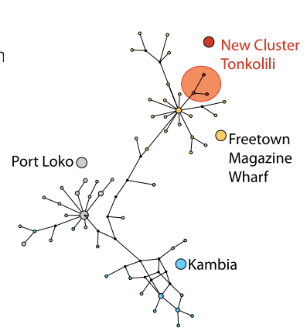
Case study: the end of ebola
A new case was found in Tonkolili, in July 2015, which had previously gone Ebola free for 130 days.
Options: un-reported cases in Tonkolili, importation from elsewhere (Guinea? Another district?), new zoonosis (therefore new outbreak)
Slide adapted from Andrew Rambaut
Notes:
Similar questions to right at the start – is this a new outbreak? Is it part of the old one? A new introduction to an area or transmission that we have missed?
Supported by epi data – the case had travelled to Freetown!
So it was an importation – informs our response

Slide 32
Case study: the end of ebola
On the 16th March, three community deaths were found to be positive in N'Zérékoré, Guinea. Guinea had been declared Ebola-free four months earlier.
Same questions – where has this come from?
Part of a strain that had last been seen in Guinea in 2014 – makes it unlikely to be unobserved transmission and also unlikely to be a new spillover
Turned out to be very similar to a sequence in the database from 2014 from a survivor - very few mutations
Epidemiological investigations found that this survivor had had sexual contact with the first case in the cluster
Semen was then tested and found to still be positive for Ebola virus, 531 days after onset of illness
Diallo et al (2016) Resurgence of Ebola Virus Disease in Guinea linked to a survivor with virus persistence in seminal fluid for more than 500 days, Clinical Infectious Diseases, 63(10) 1353-1356
Notes:
So we distinguished whether or not it was new, but also found that ebola can last in semen for a really long time, which changes the recommendationsw e make to male survivors.

